Slide 1
DATA ANALYTICS ASSESSMENTS
By
Amaya sreenivasan
Batch:7252

Slide 2

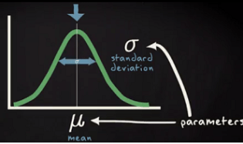

NORMAL DISTRIBUTION, BINOMIAL DISTRIBUTION & POISSON DISTRIBUTION
Normal Distribution or Gaussian Distribution or Bell Curve:
In probability theory, the normal distribution or Gaussian distribution is a very common continuous probability distribution. The normal distribution is sometimes informally called the bell curve.
The probability density of the normal distribution is:
is mean or expectation of the distribution
is the variance
In short hand notation of normal distribution has given below.

Slide 3
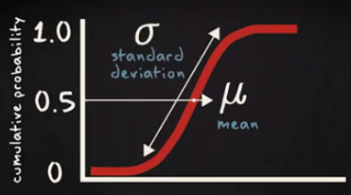
Cumulative normal probability distribution will look like the below diagram.
Properties of a normal distribution:
The mean, mode and median are all equal.
The curve is symmetric at the center (i.e. around the mean, μ).
Exactly half of the values are to the left of center and exactly half the values are to the right.
The total area under the curve is 1.

Slide 4
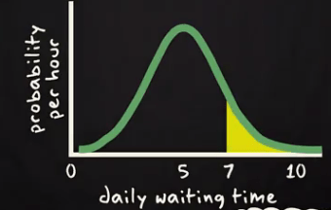
Normal Distribution Probability Calculation:
Probability density function or p.d.f. specified the probability per unit of the random variable. Here is an example of a p.d.f. of the daily waiting time by the taxi driver of Uber taxi company. In the X axis, daily waiting time and Y-axis probability per hour has been shown.
If one Uber taxi driver want to know the probability to wait more than 7 hours in a day? Then he will be interested in the yellow surface arear shown above. On basis of this graph you can estimate the area. Same thing you can get form below cumulative probability curve.

Slide 5
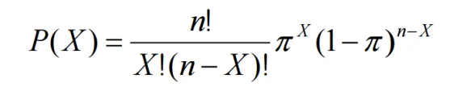
Binomial Distribution:
A distribution is said to be binomial distribution if the following conditions are met.
Each trial has a binary outcome (One of the two outcomes is labeled a ‘success’)
The probability of success is known and constant over all trials
The number of trials is specified
The trials are independent. That is, the outcome from one trial doesn’t affect the outcome of successive trials
If all the above conditions met then the binomial distribution describes the probability of X successes in n trials.
A classic example of the binomial distribution is the number of heads (X) in n coin tosses.
The Notation for a binomial distribution is
X ~ B (n, π)
which is read as ‘X is distributed binomial with n trials and probability of success in one trial equal to π ’.
Formula for Binomial Distribution:

Slide 6
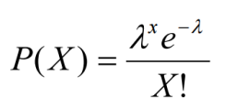
Poisson Distribution:
Like the binomial distribution and the normal distribution, there are many Poisson distributions.
Each Poisson distribution is specified by the average rate at which the event occurs.
The rate is notated with λ
λ = ‘lambda’, Greek letter ‘L’ – There is only one parameter for the Poisson distribution
The probability that there are exactly X occurrences in the specified space or time is equal to

